Slide 1

Project Review-III
Presentation on
“Skin Disease prediction using Hybrid deep learning algorithm”
By
1. Swarup Sonawane (A231)
2.Krishna Sad (A268)
3.Kartik Mohata (A273)
Under the Guidance of
Prof. Atul Patil
Department of Information Technology
MPSTME, SVKMs NMIMS Shirpur Campus
2025-26

Slide 2
Outline
  Introduction
  Literature Survey
  Problem Statement
  Objective of Project
  Design/System Architecture
  Partial implementation/Result
  References

Slide 3
Introduction
Skin disease, especially skin cancer, is among the most common and deadly cancers globally, with incidence rates continuing to rise. Accurate early detection and classification of skin lesions are critical to improving patient survival and treatment outcomes. Manual diagnosis based on visual inspection is prone to variability and can be time-consuming due to the subtle differences between benign and malignant lesions. To tackle these challenges, this project proposes an automated deep learning system that leverages a large, diverse dermoscopic image dataset to enable fast, reliable, and multi-class classification of skin diseases. The system is designed to support dermatologists by providing accurate diagnostic assistance, improving both efficiency and reliability in clinical settings, ultimately aiding in more timely and effective patient care.

Slide 4
Literature Survey
Author & Year | Method | Dataset | Accuracy | Limitation
Esteva et al. (2017) | CNN (Inception-v3) | Dermoscopic (129k) | 72% AUC (derm-level) | Requires large data
Chandran & Thomas (2022) | CNN + SVM | ISIC | 87% | Limited scalability
Mahbod et al. (2021) | Ensemble CNNs | ISIC, HAM | 89% | Computationally heavy
Xie et al. (2020) | Attention-CNN | ISIC | 85% | Lacks metadata fusion
Almaraz-Damian et al. (2020) | Feature fusion (DL+handcrafted) | HAM | 83% | Complex pipeline

Slide 5
Early and accurate diagnosis of skin disease—especially melanoma—is vital for patient survival but remains difficult due to the similar appearance of benign and malignant lesions. Manual assessment by dermatologists is time-consuming, subjective, and limited by availability. Deep learning offers automated diagnosis but struggles with data imbalance and capturing both local and global features. While CNNs capture local texture and patterns, Vision Transformers excel at modeling global context but require larger datasets. A hybrid approach combining ResNet-50 and Vision Transformer can address these limitations, providing a scalable, interpretable system that balances fine-grained local details with overall image context to improve classification accuracy across all lesion types, including rare and challenging categories. This project aims to leverage this hybrid model on the HAM10000 dermoscopic image dataset to support dermatologists in faster and more accurate skin disease classification.
Problem Statement

Slide 6
Objectives of Project
Aim is to propose to develop skin diseases detection system using detection algorithms and observe and improve the parameters like accuracy, precision, recall, F1-score, and confusion matrix evaluations.
To design and implement a hybrid deep learning model that combines ResNet-50 and Vision Transformer (ViT) for multiclass skin lesion classification using the HAM10000 dataset.
To address severe class imbalance in skin data by applying targeted augmentation and balancing strategies.
To build a scalable, interpretable, and clinically deployable AI solution for dermatological screening.

Slide 7
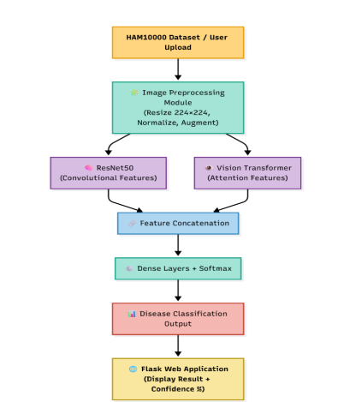
System Architecture / Workflow

Slide 8
Dataset: HAM10000 (Human Against Machine with 10000 training images) 10,015 dermoscopic images, 7 classes:
  1. NV (Melanocytic Nevi)
  2.MEL (Melanoma)
  3.BKL (Benign keratosis-like)
  4. BCC (Basal Cell Carcinoma)
  5.AKIEC (Actinic Keratoses)
  6.VASC (Vascular Lesions)
  7.DF (Dermatofibroma)
2. Metadata: Age, Sex, Localization (body part )
3. Challenges: Class imbalance, varied image resolutions
Dataset

Slide 9
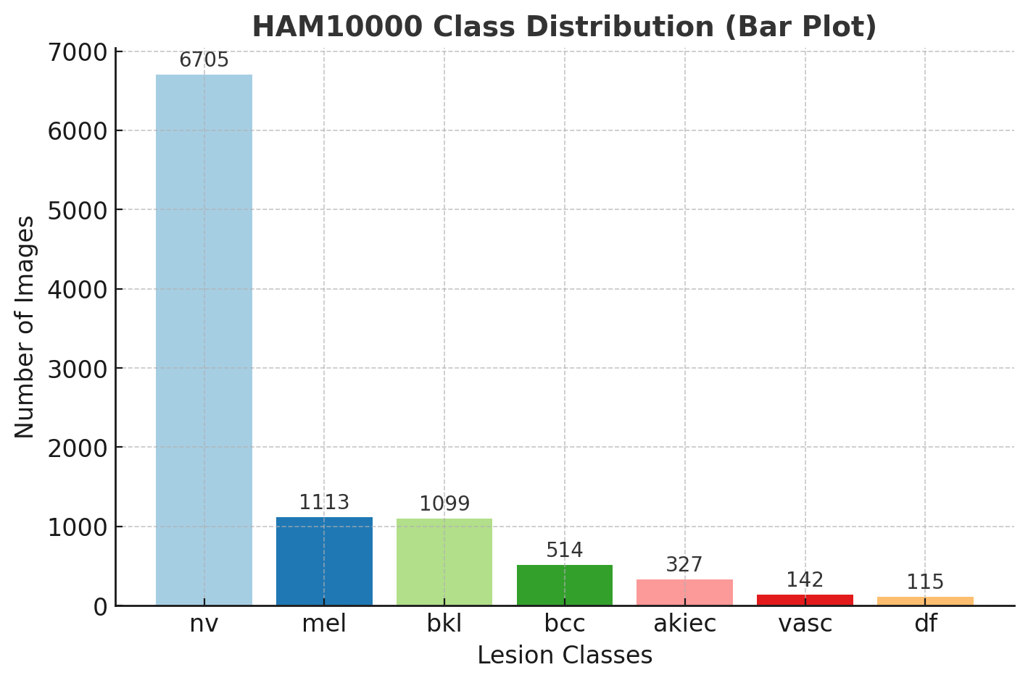

Slide 10
Class Distribution: NV >> MEL, AKIEC, VASC (imbalance problem)
Age Distribution: Most patients 20–65 years
Gender Split: ~60% female, ~40% male (approx.)
Lesion Localization: Most lesions appear on trunk, lower limbs
Key Insight: Melanoma median age higher in males vs females
Exploratory Data Analysis (EDA)

Slide 11
Handling Missing Data: Filled missing ages with mean value.
Image Preprocessing:
  Resized to 224×224×3 Normalized pixel values (0–1 range) Checked for duplicates.
Augmentation:
  Rotation (±20°).
  Horizontal & vertical flip.
  Zoom in/out (±10%).
  Shear transformation .
Balancing Classes:
  Target = 1500 images/class.
  Used augmentation for minority classes.
  Down-sampled majority classes.
Data Preprocessing

Slide 12
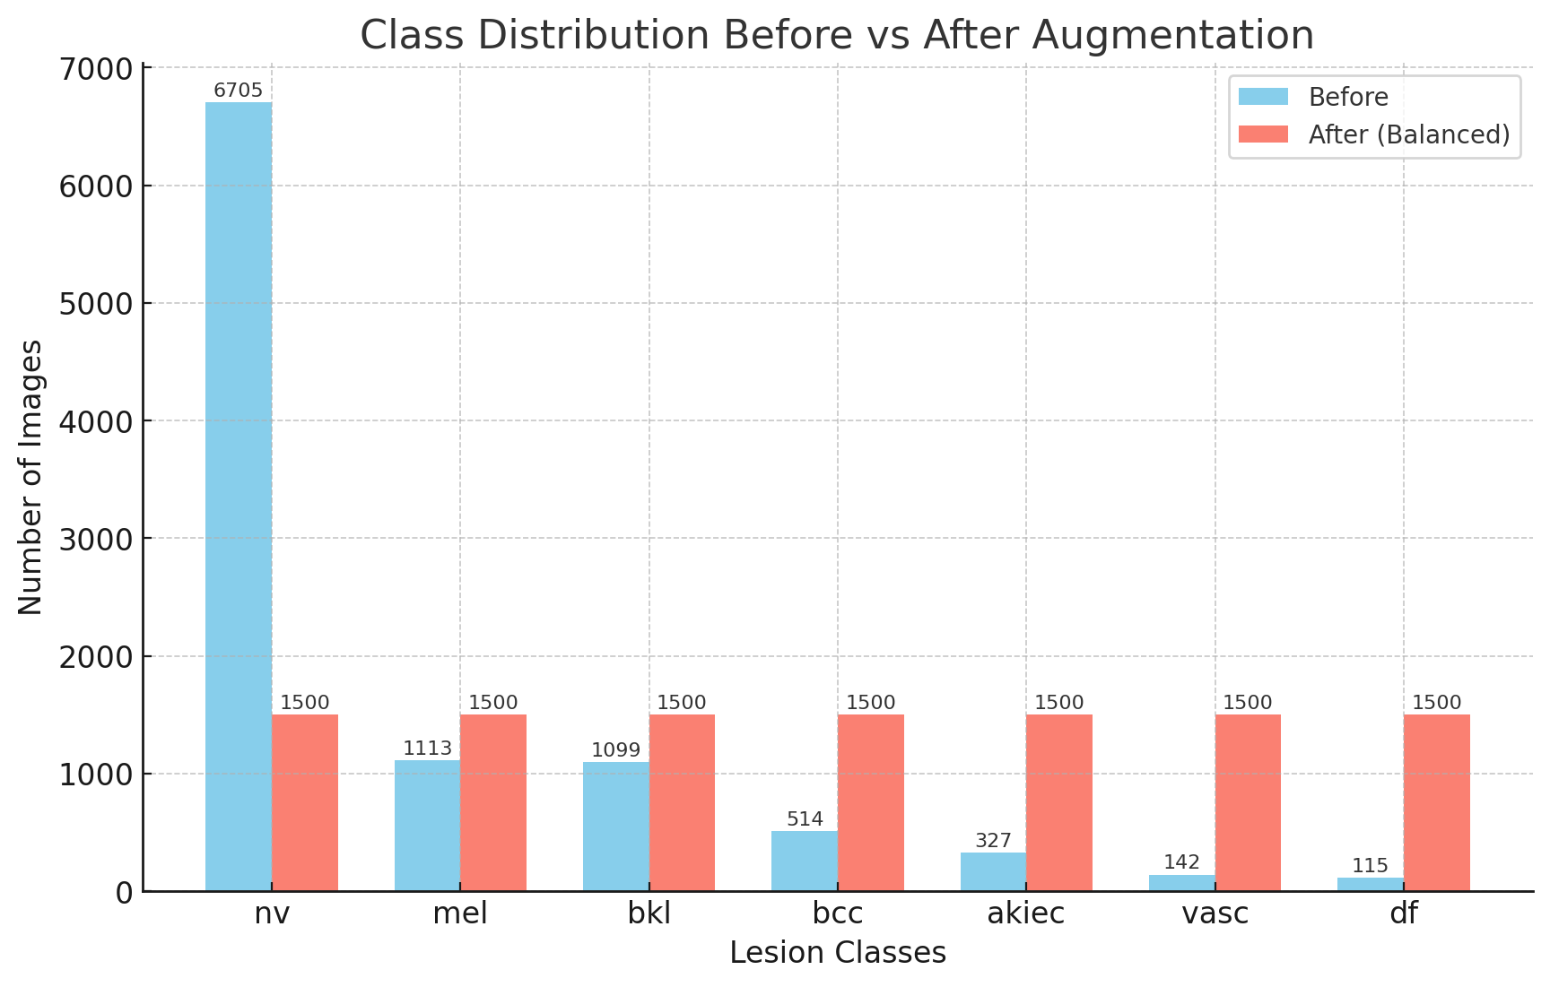

Slide 13
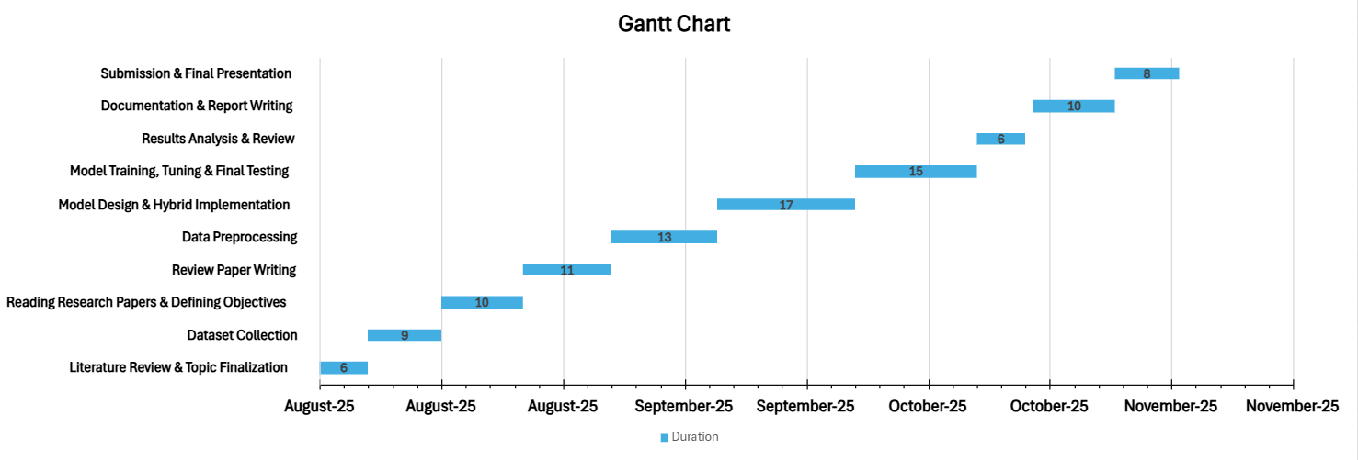

Slide 14
Methodology and Implementation
Dataset Preparation:
Used the HAM10000 dataset, which contains 10,015 dermoscopic images belonging to seven skin lesion classes.
Split data into training (64%), validation (16%), and testing (20%) sets using stratified sampling to maintain class proportions.
Preprocessing:
All images resized to 224 x 224 x 3. Normalized pixel values to for faster and more stable model training.
Applied extensive augmentation—rotation, flipping, zoom, brightness adjustment—especially for underrepresented classes to address class imbalance.

Slide 15
Hybrid Model Architecture:
Constructed a parallel architecture combining pre-trained ResNet-50 (forlocal spatial feature extraction) and Vision Transformer (ViT) branch (forglobal context modeling). ​
Outputs from both branches concatenated and passed through fullyconnected layers and a softmax classifier for multiclass prediction
Training Details:​
Used Adam optimizer with a learning rate of 1 x 10^-4, batchsize of 32, and cosine annealing schedule. ​
Training performed for 25 epochs with early stopping of 10 epochspatience to prevent overfitting.​
Loss function: Categorical cross-entropy. ​
Evaluation Strategy:
Monitored performance on validation set using metrics: accuracy,precision, recall, F1-score.
Final model assessed on the test set, including confusion matrix andclass-wise performance analysis.

Slide 16
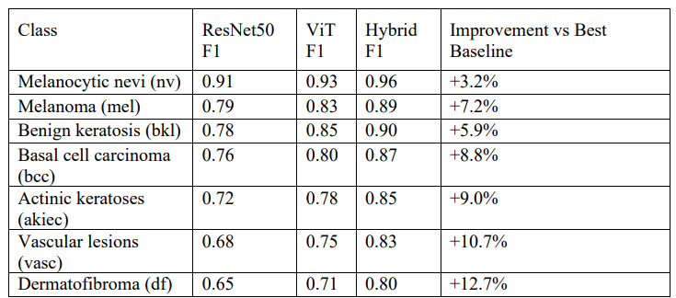
Result and Analysis
The proposed hybrid model (ResNet-50 + Vision Transformer) achieved an overall accuracy of 77.4% on the HAM10000 test set, demonstrating significant improvement over standalone architectures.

Slide 17
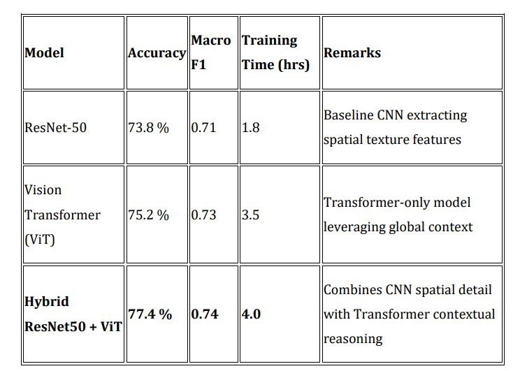
Class-Wise Analysis:
The hybrid model maintained high precision and recall even for rare classes, such as Dermatofibroma (DF) and Vascular Lesion (VASC), proving the effectiveness of aggressive data augmentation and class balancing.
Confusion Matrix:
The confusion matrix shows most predictions occur on the diagonal, confirming robust true-class detection. Overall test accuracy from confusion matrix:

Slide 18
Learning Curves:
Accuracy and loss graphs indicate fast convergence during training, low overfitting, and stable validation performance.
Ablation Study:
Adding Vision Transformer and advanced augmentation improved F1-score and recall. Both attention mechanism and fusion techniques were crucial for reaching top metrics.
Conclusion of Analysis:
These results validate that combining CNN and transformer architectures with careful data handling enables reliable, scalable, and clinically valuable skin lesion classification.

Slide 19
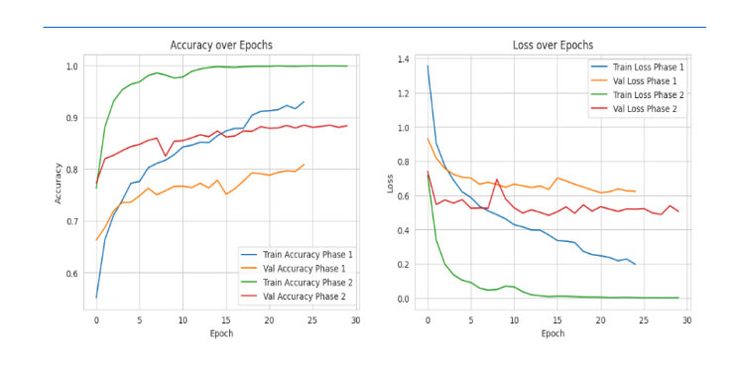
ResNet-50

Slide 20
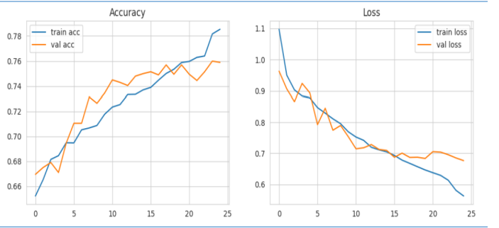
ResNet-50 +VIT

Slide 21
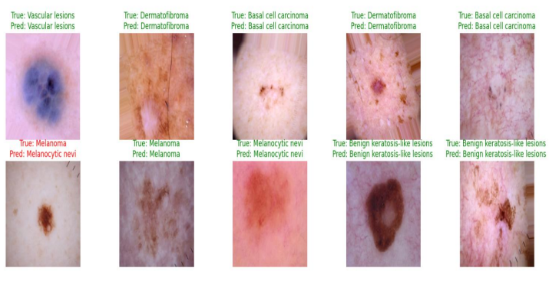

Slide 22
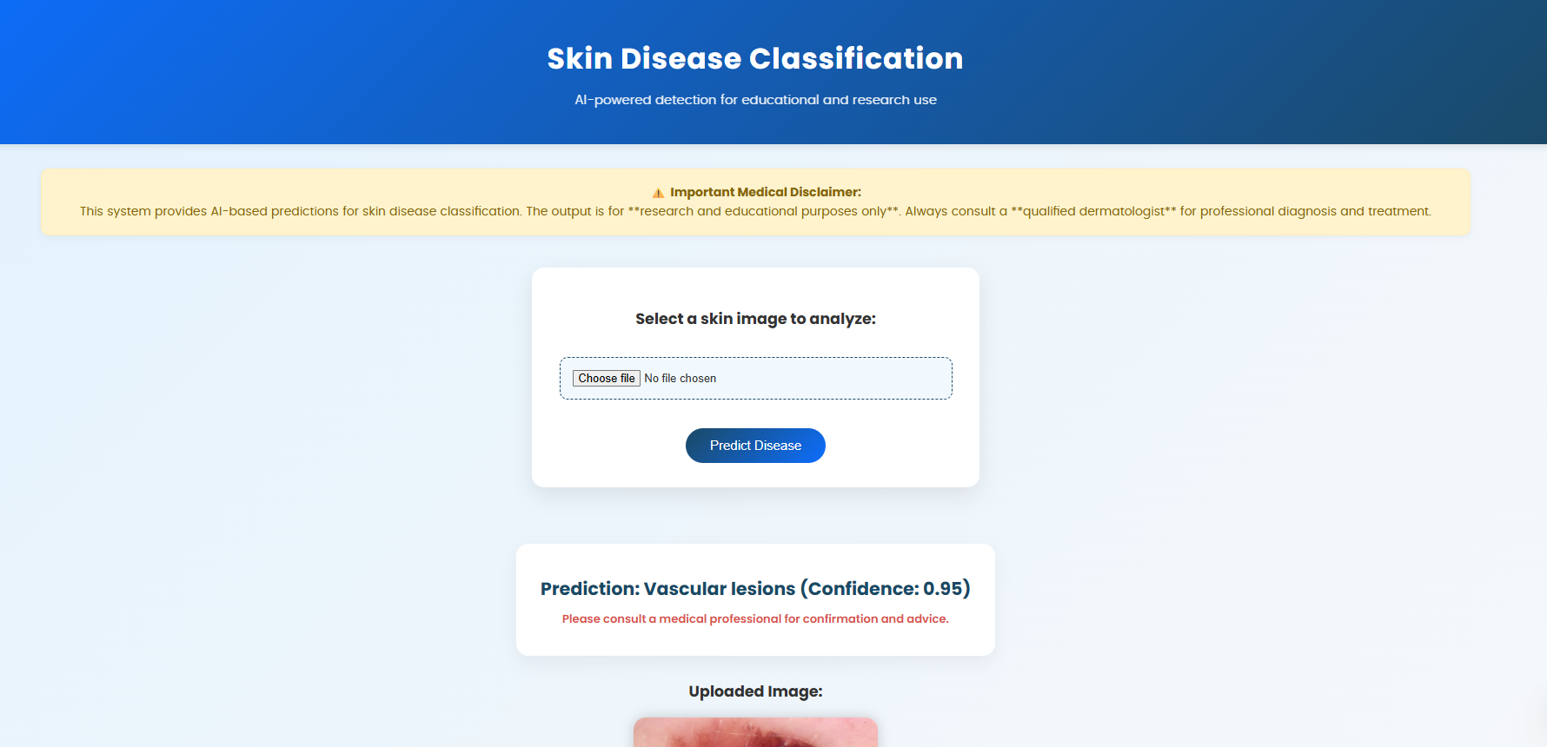
Flask + ml

Slide 23
Conclusion
The hybrid deep learning model developed in this project, combining ResNet-50 with Vision Transformer, has demonstrated superior performance in multiclass skin lesion classification on the HAM10000 dataset.
Through advanced augmentation and class balancing, the system achieved high accuracy, precision, recall, and F1-score, especially improving detection for rare and challenging lesion types.
These findings establish the proposed approach as both reliable and clinically valuable for automated skin cancer screening.
The project's outcomes highlight the potential of hybrid architectures to enable more accurate, scalable, and interpretable diagnostic tools in medical imaging.

Slide 24
Large-scale Diverse Datasets: Expand training and validation using diverse, globally representative datasets to improve generalization across populations.
Lightweight and Efficient Models: Optimize the hybrid architecture for deployment on mobile and embedded devices to enable real-time dermatological screening in resource-limited areas.
Clinical Trials and Deployment: Collaborate with healthcare providers to validate models in clinical settings and integrate into telemedicine platforms for improved access.
Explainability and Interpretability: Incorporate techniques such as Grad-CAM and attention visualization to make model decisions transparent and clinically trustworthy.
Future Work

Slide 25
Tschandl et al. (2018) – Introduced HAM10000 dataset for skin lesion classification.
Esteva et al. (2017) – Achieved dermatologist-level skin cancer detection using CNNs.
Codella et al. (2019) – Organized ISIC challenge for melanoma detection.
Kassani et al. (2020) – Proposed deep learning-based melanoma detection framework.
Chandran & Thomas (2022) – Developed CNN-SVM hybrid model for skin disease classification.
Ahmed et al. (2022) – Provided a comprehensive review of DL in skin disease diagnosis.
Mahbod et al. (2021) – Used multi-network ensemble transfer learning for lesion classification.
Xie et al. (2020) – Applied attention-based CNNs for skin lesion recognition.
Almaraz-Damian et al. (2020) – Proposed feature fusion (handcrafted + DL) for melanoma vs nevus.
Yadav & Jadhav (2023) – Compared transfer learning methods for dermatology imaging.
Tajbakhsh et al. (2016) – Studied fine-tuning vs full training of CNNs for medical imaging.
References

Slide 26
Thank you!

